Slide 1

Cloud Computing and Distributed Systems
Session-1
Mayank Taneja,
Teaching Assistant

Slide 2
Week-0 Questions
The physical layer concerns with____________________
A. Bit-by-bit delivery
B. Process to process delivery
C.Application to application delivery
D. None of the mentioned

Slide 3
Concurrent access to shared data may result in________________________
A. Data consistency
B. Data insecurity
C. Data inconsistency
D. None of the mentioned

Slide 4
Which condition must be satisfied to solve the critical section problem :
A. Mutual Exclusion
B. Progress
C. Bounded Waiting
D. All of the mentioned

Slide 5
Mutual exclusion implies that :
A. If a process is executing in its critical section, then no other process must be executing in their critical sections
B. If a process is executing in its critical section, then other processes must be executing in their critical sections
C. If a process is executing in its critical section, then all the resources of the system must be blocked until it finishes execution
D. None of the mentioned

Slide 6
Which layer is responsible for the process-to-process delivery ?
A. Network
B. Transport
C. Application
D. Physical

Slide 7
An interrupt that can be temporarily ignored is
A. Vectored interrupt
B. Non-maskable interrupt
C. Maskable interrupt
D. High priority interrupt

Slide 8
What is the default subnet mask for a class C network?
A. 127.0.0.1
B. 255.0.0.0
C. 255.255.0.0
D. 255.255.255.0

Slide 9
Which of the following device is used to connect two systems, especially if the systems use different protocols?
A. Hub
B. Bridge
C. Gateway
D. Repeater

Slide 10
A distributed network configuration in which all data/information pass through a central computer is
A. Bus network
B. Star network
C. Ring network
D. Point-to-point network

Slide 11
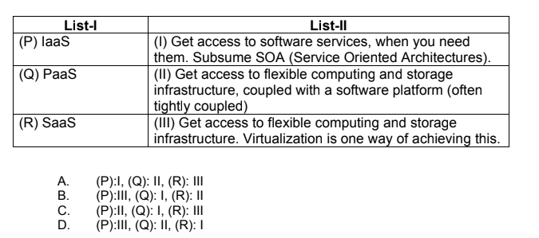
Week-1 Questions
Match the following two list:

Slide 12
Answer - D
Examples of
IaaS - AWS, DigitalOcean etc.
PaaS - Google App Engine
SaaS - Google Docs

Slide 13
True or False ?
Distributed computing system uses multiple computers to solve large-scale problems over the Internet. Thus, distributed computing becomes data-intensive and network-centric.
A. True
B. False

Slide 14
______________computing focuses on a business model in which customers receive computing resources from a paid service provider.
A. Utility
B. Grid
C. Cluster
D. Parallel

Slide 15
Choose the correct items for X, Y, and Z.
X is an example of SaaS, Y is an example of PaaS, and Z is an example of IaaS
A. X-Google App Engine, Y-Eucalyptus, Z-Google Docs
B. X-Google Docs, Y-Google App Engine, Z-Eucalyptus
C. X-Eucalyptus, Y-Google Docs, Z-Google App Engine
D. X- Google Docs, Y-Eucalyptus, Z- Google App Engine

Slide 16
Which of these statements are correct?
Statement-1: Moore’s law indicates that network bandwidth doubles every 18 months.
Statement-2: Gilder’s law indicates that processor speed has doubled each year in the past.
A. Only statement 1 is correct
B. Only statement 2 is correct
C. Both statements are correct
D. Both statements are false

Slide 17
_____________________is where a VM can be moved from one physical machine to another even as it continues to execute.
A. Load Balancing
B. Live Migration
C. Migration
D. Server consolidation

Slide 18
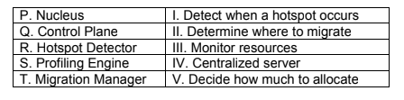
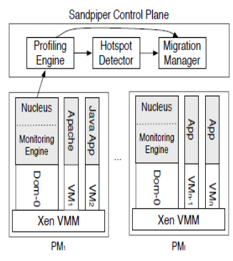
Consider the following regarding the Sandpiper architecture:
A. P: I,Q: II, R:III, S:IV, T:V
B. P: IV,Q: III, R:I, S:V, T:II
C. P: III,Q: V, R:I, S:IV, T:II
D. P: III,Q: IV, R:I, S:V, T:II

Slide 19
Answer: D) P: III,Q: IV, R:I, S:V, T:II
Explanation:
Nucleus: Monitor resources
Control Plane: Centralized server
Hotspot Detector: Detect when a hotspot occurs
Profiling Engine: Decide how much to allocate
Migration Manager Determine where to migrate

Slide 20
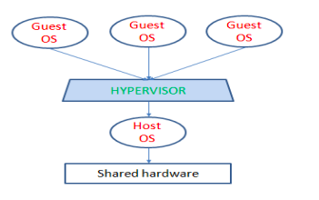
Which type of Hypervisor is shown in the following figure ?
A. Type 1
B. Type 2
C. Type 3
D. All of the mentioned

Slide 21
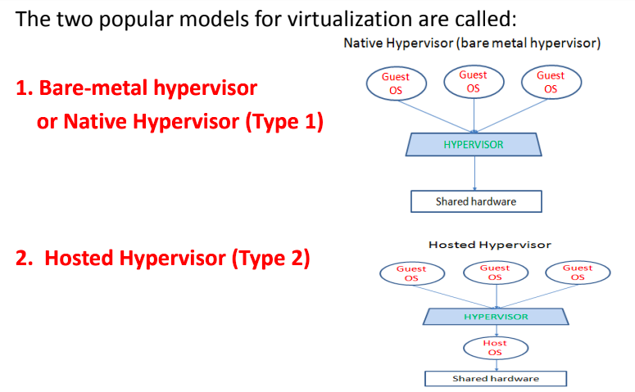

Slide 22
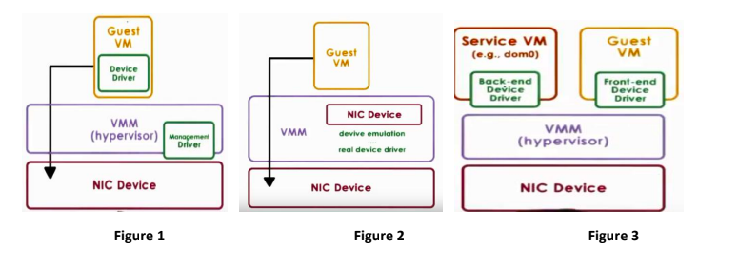
Which of the following figure is the example of Passthrough Model:
A Figure 1
B Figure 2
C Figure 3
D None of the mentioned

Slide 23
Answer - Figure 1
Figure 1 - Pass-through model
Figure 2 - Hypervisor-Direct Model
Figure 3 - Split-Device Driver Model

Slide 24
Fill in the blanks:
__________________________method access to OS states and application logs.
_____________________ method is completely OS and application agnostic.
A) Black-box, Gray-Box
B) Gray-Box, Black-box
C) Black-box, White-Box
D) Gray-box, White-Box

Slide 25
Answer: B) Gray-Box, Black-box
Explanation:
Gray-Box: access to OS states and application log
Black-box: only data from outside the VM Completely OS and application agnostic

Slide 26
Week-2 Questions
Which of these statements are correct?
Statement-1: Live VM migration is an open-source project that automates the deployment of applications inside software containers, by providing an additional layer of abstraction and automation of OS–level virtualization on Linux.
Statement-2: The Docker Engine container comprises just the application and its dependencies. It runs as an isolated process in userspace on the host operating system, sharing the kernel with other containers.
A. Only statement 1 is correct
B. Only statement 2 is correct
C. Both statements are correct
D. Both statements are false

Slide 27
Answer: B) Only statement 2 is correct
Explanation: Correct statements are:
Statement-1: Docker is an open-source project that automates the deployment of
applications inside software containers, by providing an additional layer of
abstraction and automation of OS–level virtualization on Linux.
Statement-2: The Docker Engine container comprises just the application and its
dependencies. It runs as an isolated process in userspace on the host operating
system, sharing the kernel with other containers.

Slide 28
Choose the correct items for X, Y, and Z.
X enables you to separate your applications from your Y so you can deliver
software quickly. With X, you can manage your Y in the same ways you
manage your applications. X provides the ability to package and run an
application in a loosely isolated environment called a Z.
A. X- Infrastructure, Y- Docker, Z- Container
B. X- Container, Y- Infrastructure, X- Docker
C. X- Container, Y- Docker, Z- Infrastructure
D. X- Docker, Y- Infrastructure, Z- Container

Slide 29
Answer: D) X- Docker, Y- Infrastructure, Z- Container
Explanation: Docker enables you to separate your applications from your
infrastructure so you can deliver software quickly. With Docker, you can manage
your infrastructure in the same ways you manage your applications. By taking
advantage of Docker’s methodologies for shipping, testing, and deploying code
quickly, you can significantly reduce the delay between writing code and running it in
production. Docker provides the ability to package and run an application in a loosely
isolated environment called a container.

Slide 30
Consider the following statements:
Statement 1: In Single-root I/O Virtualization (SR-IOV), forwarding is no longer as flexible because it relies on a layer two switch that is built into the hardware of the NIC.
Statement 2: In Single-root I/O Virtualization (SR-IOV), the live VM migration becomes trickier, because the virtual machine is tied to physical resources of the machine.
A. Only statement 1 is true
B. Only statement 2 is true
C. Both statements are true
D. Both statements are false

Slide 31
Answer: C) Both statements are true
Explanation: The downsides to Single-root I/O Virtualization (SR-IOV) approach
are:
Live VM migration becomes trickier, because now you've tied the virtual machine to
physical resources on that machine.
The forwarding state for that virtual machine now resides in the layer two switch
inside the NIC.

Slide 32
_______________is a network emulator which creates realistic virtual network.
It runs real kernel, switch and application code on a single machine and provides
both Command Line Interface (CLI) and Application Programming Interface (API)
A. Docker
B. Hypervisor
C. Mininet
D. KVM

Slide 33
Answer: C) Mininet
Explanation: Mininet is a network emulator which creates realistic virtual network. It runs real kernel, switch and application code on a single machine and provides both Command Line Interface (CLI) and Application Programming Interface (API).

Slide 34
Identify the correct key ideas for software-defined networking architecture:
Statement 1: Low-level interface and programmatic interface for the data plane.
Statement 2: Logically centralized controller that allows us to build software
abstractions on top of it.
A. Only statement 1 is true
B. Only statement 2 is true
C. Both statements are true
D. Both statements are false

Slide 35
Answer: C) Both statements are true
Explanation: Key ideas software-defined networking architecture:
Division of Policy and Mechanisms-
Low-level interface and programmatic interface for the data plane.
Logically centralized controller that allows us to build software abstractions on top of it.

Slide 36
What are the two key design goals for Open vSwitch?
A. Scalability and partitioning
B. Isolation and tunnelling
C. Flexible and fast-forwarding
D. Reliability and filtering

Slide 37
Answer: C) Flexible and fast-forwarding
Explanation: Open vSwitch design goals are flexible and fast-forwarding.

